Slide 1
The BitTorrent Protocol

Slide 2
What is BitTorrent?
A widely used peer to peer (P2P) protocol
Used for quickly distributing large files to many users

Slide 3
Major Sections
The Basics of Peer to Peer Protocols
  Napster
  FastTrack
  Direct Connect
The BitTorrent Protocol
  Torrent Files
  Trackers
  Peer to Peer communications

Slide 4
Napster
First popular peer to peer protocol designed for file sharing
Files no longer stored on a central server
Searching performed by a central server

Slide 5
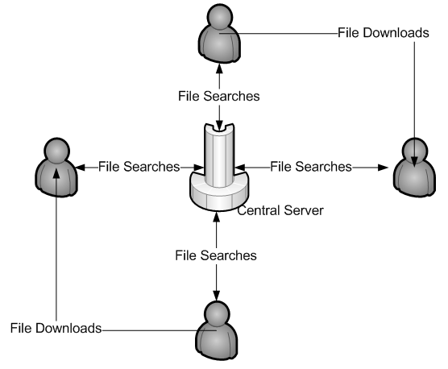
Napster

Slide 6
Napster
Napster was shut down in 2001 because of lawsuits
  Central searching meant that Napster could have filtered search results to not include copyrighted material

Slide 7
FastTrack
Use of super nodes instead of a central server
File transfers done with HTTP

Slide 8
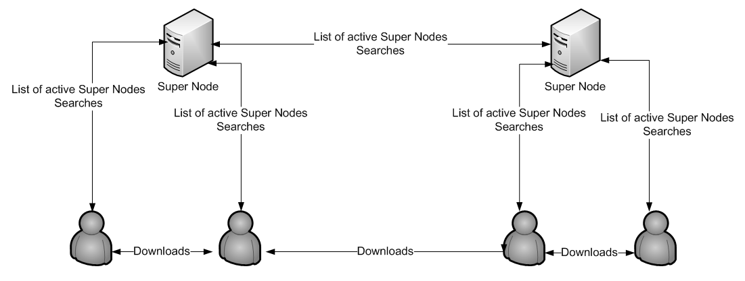
FastTrack

Slide 9
FastTrack
The FastTrack protocol had many problems
  Spyware and adware plagued the official client (Kazaa)
  Weak hashing algorithm (UUHash) resulting in massive file corruption

Slide 10
Direct Connect
Originally closed source, but was reverse engineered
Some similarities to Napster
  Dedicated servers known as hubs performed searches
  Hubs were run independently of each other
  Users could connect to many hubs at once

Slide 11
Problems With Basic Protocols
Flash crowds
  New large files are slow to spread on these protocols
Leeching
  Napster, FastTrack and Direct Connect had no built in leecher protection

Slide 12
BitTorrent
Developed by Bram Cohen in 2001
BitTorrent is not a stand alone application
No built in facilities for searching
Torrent files used for distribution
Trackers used to help peers find each other
Peers transfer pieces instead of files
  About 1 kilobyte in size

Slide 13
The BitTorrent Protocol
Torrent file structure
Client and Tracker Communications
Peer to Peer Communications

Slide 14
Torrent File Structure
Torrent files are bencoded
Torrent files contain the information needed to ensure a file is downloaded error free
  20 byte SHA1 hashes of each piece
  The size of each piece
  The names and directory structure of the files being downloaded
Torrent files also contain the URL of the tracker

Slide 15
Client and Tracker Communication
A tracker is a specialized HTTP server
Connectivity is done through HTTP GET requests
Parameters sent to the tracker in the standard CGI format
Response in a bencoded form

Slide 16
Client to Tracker Communications
info_hash field contains a SHA1 hash of a part of torrent file
  Used to identify which torrent the client is referring to
peer_id field is a 20 byte string arbitrarily chosen by the client at startup
  Used as an identifier because multiple clients can be using 1 IP address

Slide 17
Client to Tracker Communications
The optional IP field specifies the IP address that will be given to other clients
  Only required if the client and tracker are using the same external IP address
  Otherwise the clients IP address can be determined by the origin of the request

Slide 18
Client to Tracker Communications
The port field states which port the client is listening on
  Typical values are 6880 to 6889 but any valid port outside of reserved ports can be used.

Slide 19
Client to Tracker Communications
Statistics tracking on the tracker side can be accomplished using 3 fields
  Uploaded
  Downloaded
  Left
All 3 fields are mandatory

Slide 20
Client to Tracker Communications
The event field is optional and can contain 3 possible values
  Started
  Completed
  Stopped

Slide 21
Client to Tracker Communications
The numwant field specifies how many peers the client would like the tracker to respond with
  Optional
  Defaults to 50
  Can also be 0
The tracker is not always able to respond with as many peers as requested

Slide 22
Client to Tracker Communications
If the compact field is present, the tracker may generate a smaller response to save bandwidth
  All of the same information will be present in the response

Slide 23
Tracker to Client Communications
Tracker response is bencoded
Contains a list of peers participating in the same swarm
Contains information about the swarm
Tells the client when to send the next request

Slide 24
Tracker to Client Communications
Interval
  How long to wait before requesting more peers
Min interval
  How long to wait before requesting more peers if the client has no connections
Interval is sometimes used for both

Slide 25
Tracker to Client Communications
Complete
  How many leechers are in the swarm
Incomplete
  How many seeds are in the swarm

Slide 26
Tracker to Client Communications
The tracker also includes a list of peers in the response
  Peer_id
    Omitted in a compact response
  IP
  Port

Slide 27
Peer to Peer Communications
This is the part of the protocol where actual data transfer takes place
Connectivity is built on top of TCP/IP
Communication takes place through messages

Slide 28
Peer to Peer Communications
A client must track some status information for each client it is connected to
  Is the client interested in the peer?
  Is the client choking the peer?
  Is the peer interested in the client?
  Is the peer choking the client?
These are updated through special messages

Slide 29
Peer to Peer Communications
The interest and choking state is vital to the leeching protections built into BitTorrent
Proper implementation is very tricky

Slide 30
Peer to Peer Communications
After TCP connectivity has been established, handshake messages must be sent
Following the handshaking process, peers can send each other bitfield messages
  Describe which pieces the sending peer has completed

Slide 31
Peer to Peer Communications
As pieces are downloaded, peers send each other have messages
  This is done to encourage unchoking
Clever sending of have messages is one of the keys to reducing protocol overhead
  “Have Suppression”

Slide 32
Peer to Peer Communications
Peers request data from each other through use of request messages
  Requests are typically for partial pieces known as blocks
Peers receiving a request should place it into a queue
  Can be altered based on interest and choking status

Slide 33
Peer to Peer Communications
Cancel messages are used to cancel a pending request
  Cancelling is useful during “End Game”

Slide 34
Peer to Peer Communications
Piece messages are where the data transfer takes place
  Each piece message contains the same indexes found inside the corresponding request
  The amount of data sent can be determined from the length of the TCP frame

Slide 35
Conclusion
Major Sections covered
  Basic Protocols
    Napster
    FastTrack
    Direct Connect
  BitTorrent Protocol
    Torrent file structure
    Tracker announce requests
    Peer to peer communications

